Slide 1


How to use yt-dlP For WIN11
By Astrid Vár

Slide 2
What is yt-dlp
yt-dlp is a feature-rich command-line audio/video downloader with support for thousands of sites. The project is a fork of youtube-dl based on the now inactive youtube-dlc.
YT-DLP GitHub I used the yt-dlp.exe for windows. There are many other OS and platforms that may be used.

Slide 3
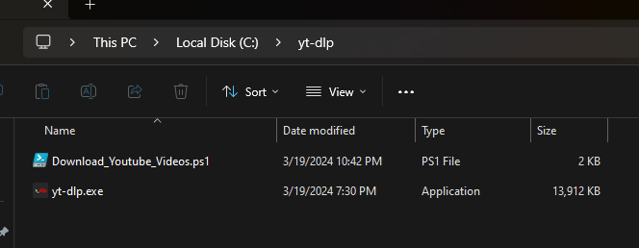
Were to install it?
Make a folder in any location you like . I used C:\yt-dlp as to make scripting easier.

Slide 4
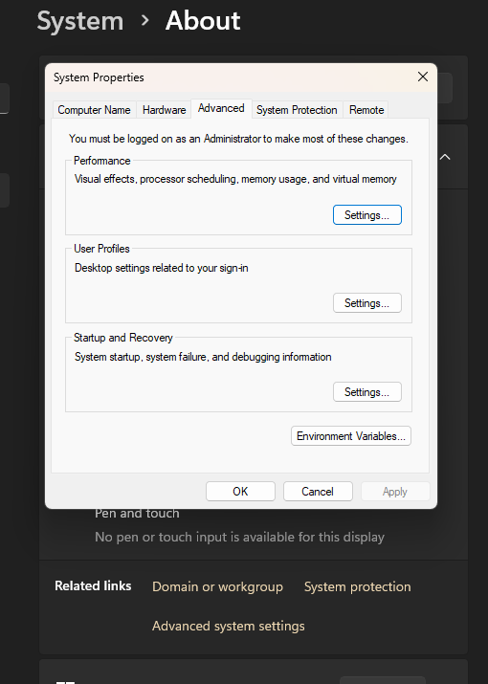
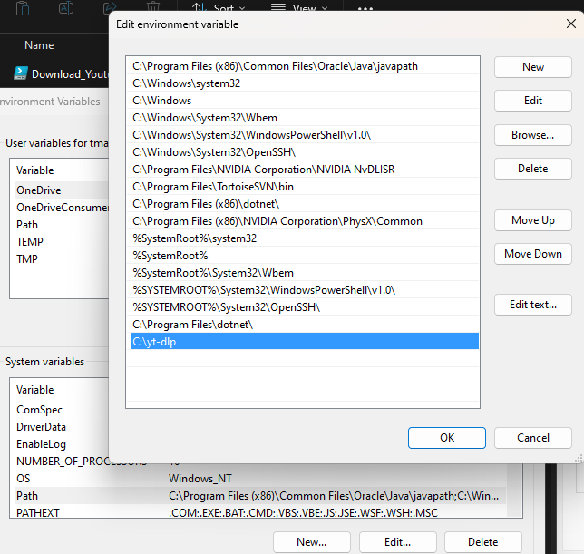
Installing continued
Open the advanced systems settings and select environment variables.
Then inside of the system variables edit the PATH options.
Select new and add the full folder path of the yt-dlp location and save.
That is it. Installation completed.

Slide 5
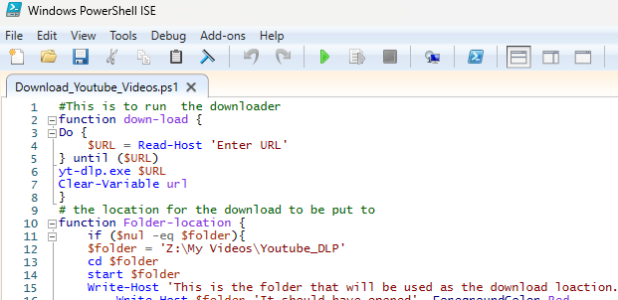
The Fun Stuff
The script that was made by PowerShell ISE.
The Script will be in the Zip.
With the script the only thing that needs to be changed is the folder path you want yt-dlp to save the media. I have a NAS so I used that. When completed just save the PS1 inside of your yt-dlp folder location.

Slide 6
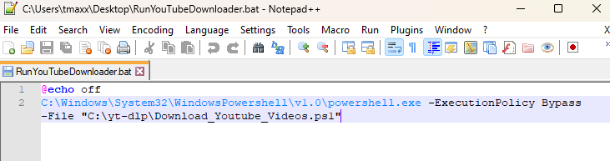
We are almost there……
The batch file. So, it will also be in the zip. You will have to change the file location of the PS1 to the file path you have. And again, this is made for windows 11. Save the batch to the Desktop.
NEXT

Slide 7
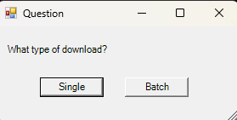
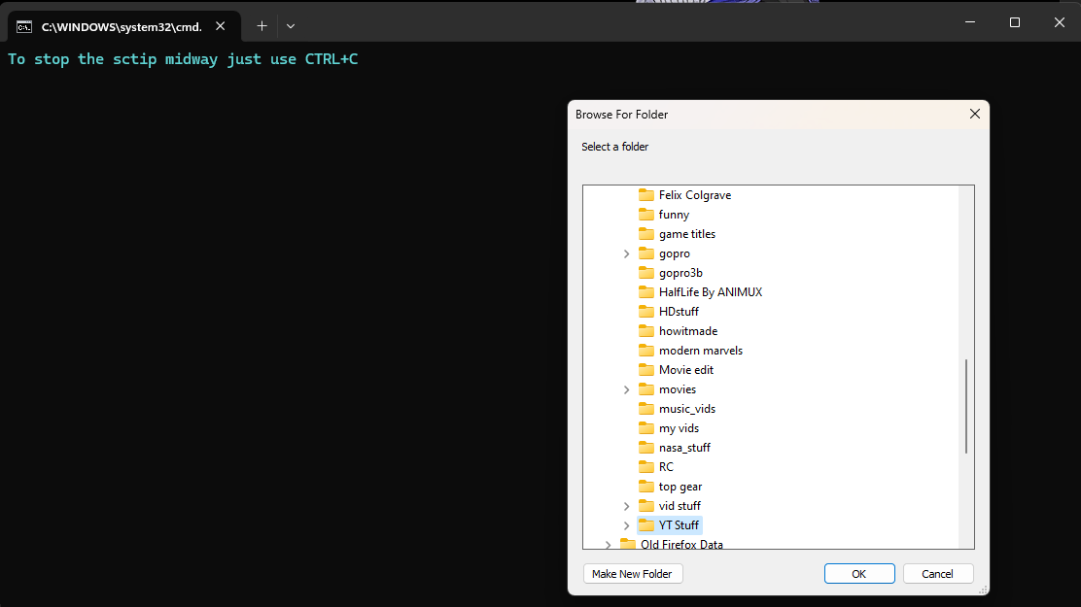
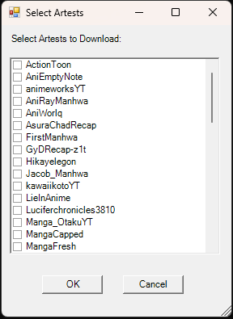
The Fun Stuff
Now just open the newly made .bat file.
An interactive selector will popup. Select your download type.
To the left is form for batch select and right is the single folder selector.

Slide 8
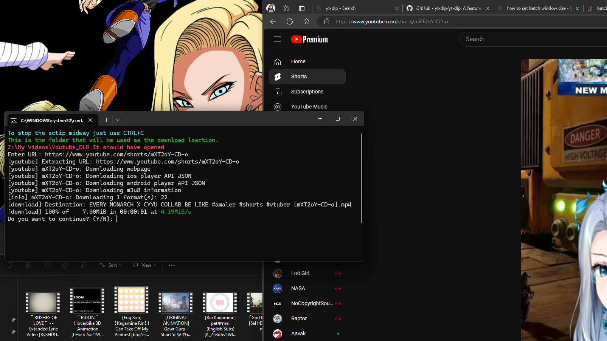
And Enjoy You madeit. Go download…

